Slide 1
Mine Detonating Sphere-bot
ROCO504
critical Design Review
Charlie Freestone & Becky Harding

Slide 2
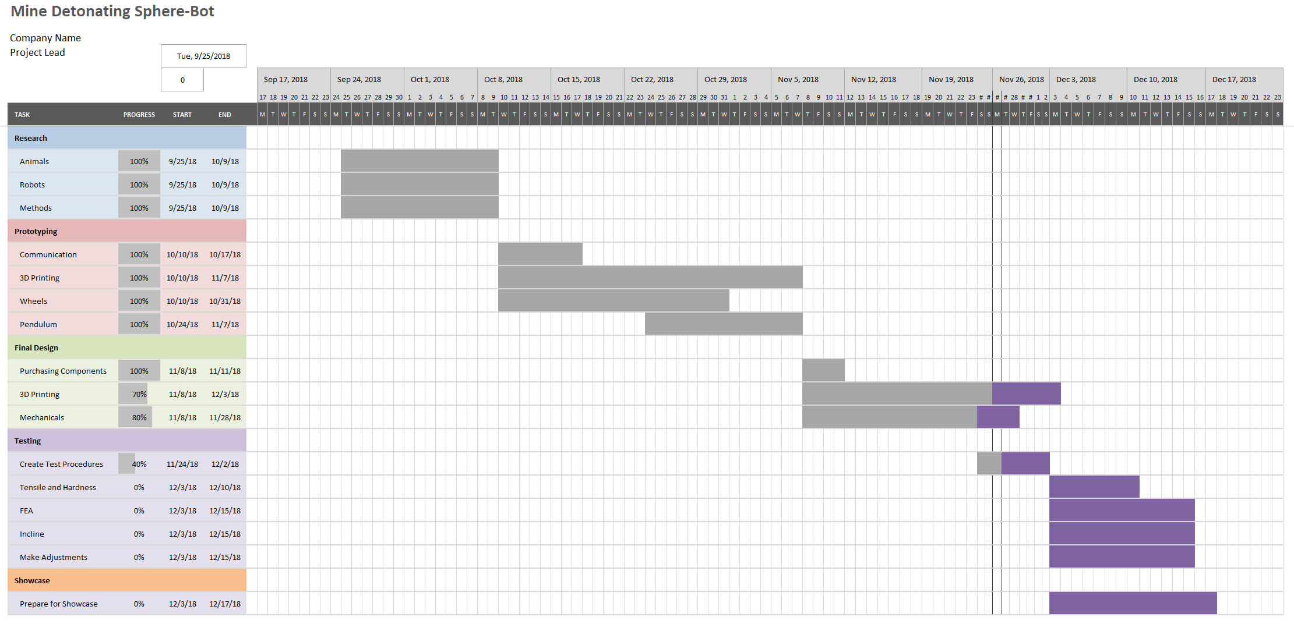
Updated Project Plan

Slide 3
Suggestions from PDR
Working out what incline the robot can deal with
Using Kevlar on the outside to protect the robot
Creating soft/protected wheels for the inner robot
Using GPS for mapping
Creating many robots, as a swarm
Damage checking with LDRs
Gyroscopic effect jumping
Adding grip
Motor torque vs speed
Notes:
Write a nice bullet point list of the mechanical and electrical changes – ALL CHANGES DISCUSSED, not just WHAT we did –
So include the swarm robotics stuff here and then discuss on next couple slides

Slide 4
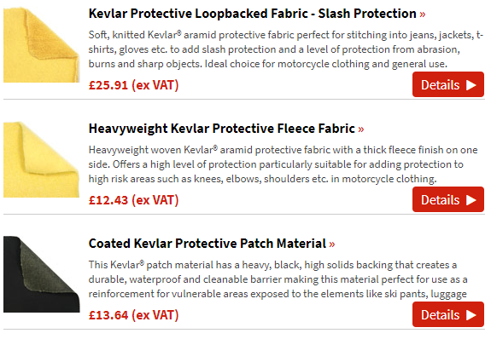
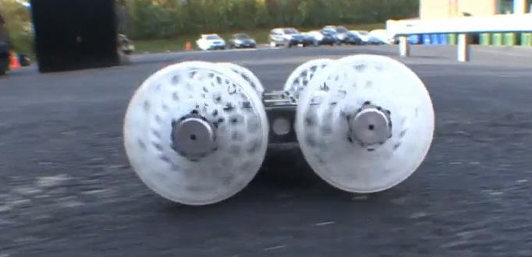
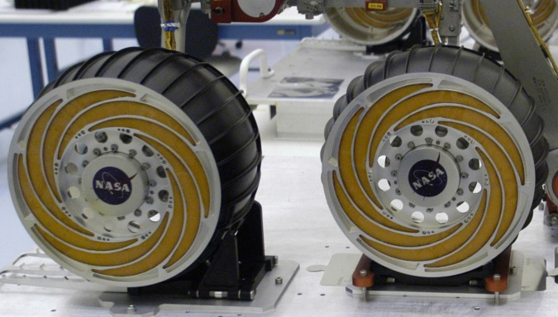
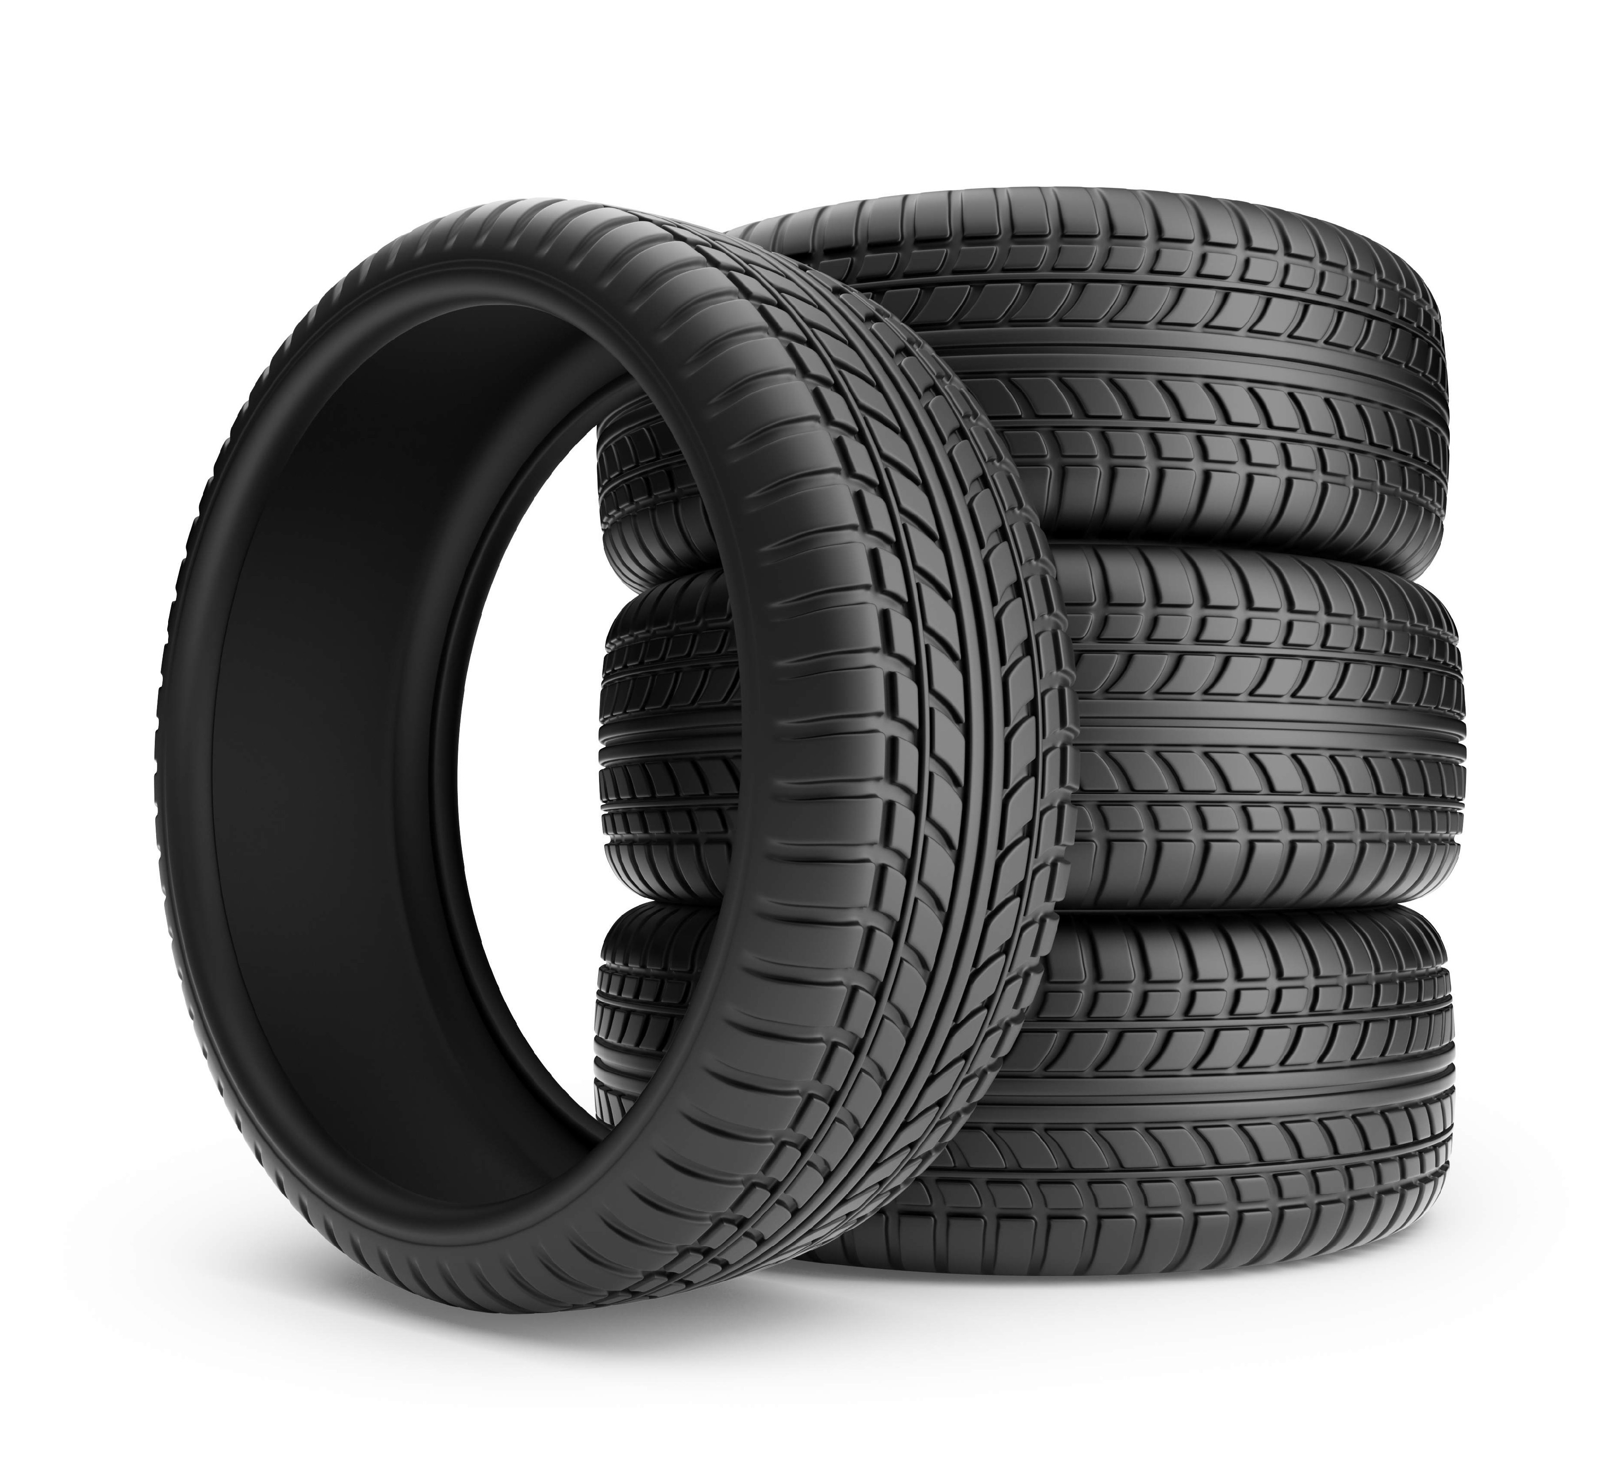
Items in PDR brought into current design
Working out what incline the robot can deal with
Using Kevlar on the outside to protect the robot
Creating soft/protected wheels for the inner robot
Damage checking with LDRs
Adding grip
Motor torque vs speed
http://www.easycomposites.co.uk/#!/fabric-and-reinforcement/kevlar-aramid-diolen-etc/kevlar-protective-textiles
http://amazingvideostgs.blogspot.com/2012/12/sand-flea-jumping-robot.html
https://mars.nasa.gov/mer/spotlight/wheels01.html
http://www.qwiktyres.com/
Notes:
Bullet point list of items that where on last slide that we are incorporating into our design

Slide 5
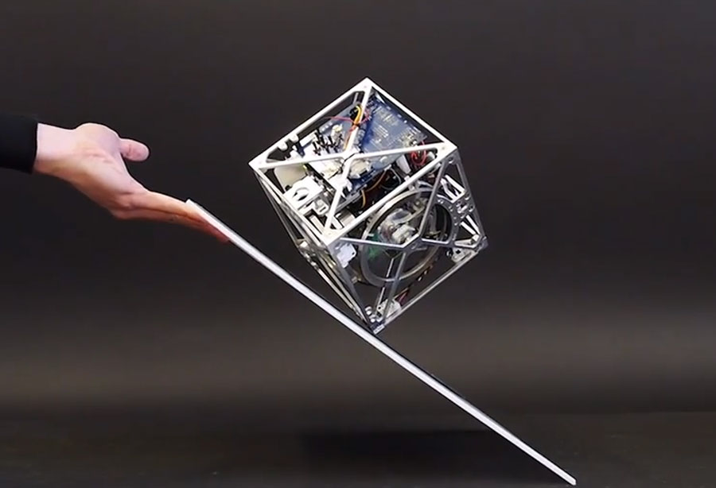
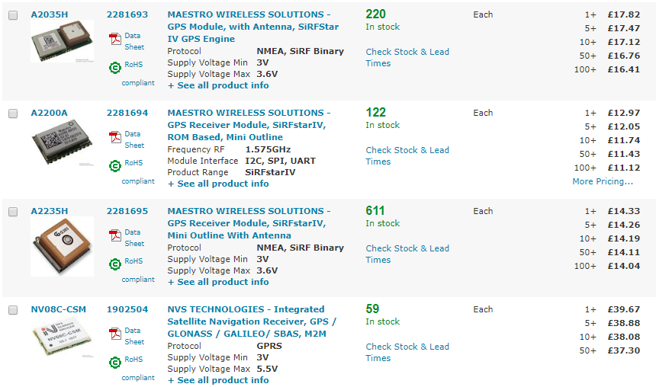
Things for the Future
Using GPS for mapping
Creating many robots, as a swarm
Gyroscopic effect jumping
https://robohub.org/swiss-robots-cubli-a-cube-that-can-jump-up-balance-and-walk-across-your-desk/
https://uk.farnell.com/w/c/wireless-modules-adaptors/communications-networking-modules/gps-modules-receivers?range=inc-in-stock&st=gps
Notes:
Discussion on items that we couldn’t encorportate like the swarm and gps.
*when it comes to talking on this slide you can say how its something our design will be able to do but its not in the SCOPE of what we want to achieve

Slide 6
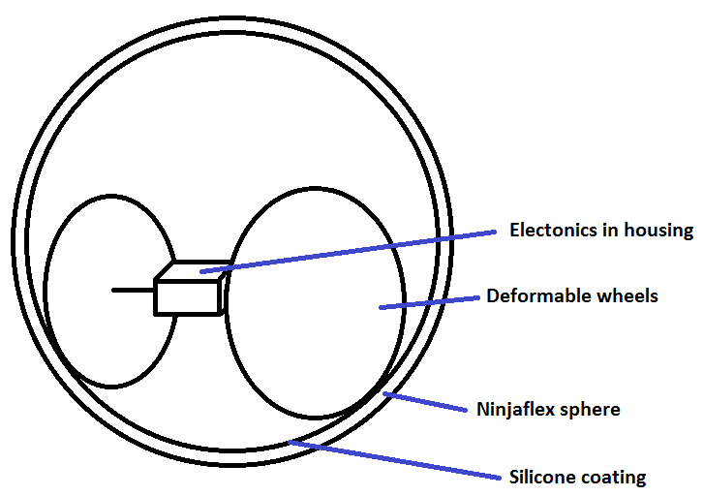
Final Design
Definitely wheeled rather than pendulum idea
Deformable wheels in a deformable sphere – maximise protection of the internals
Going to test many wheel ideas to choose the best
Making the sphere out of NinjaFlex and coating the inside with silicon
Friction coefficient of NinjaFlex: 0.45
Friction coefficient of silicone: 0.3
Notes:
*Discussion from PDR led to the use of honeing in on just using the wheeled bot inside of a sphere idea
Redesigned scope
Springed wheels around a spongy sphere
Tests to be taken

Slide 7
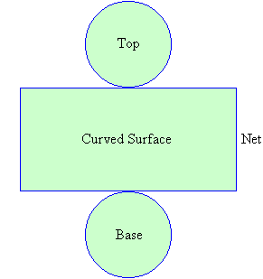
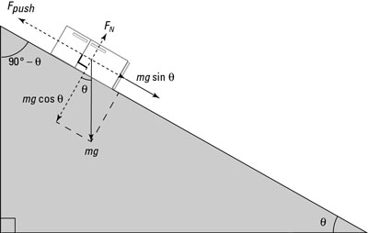
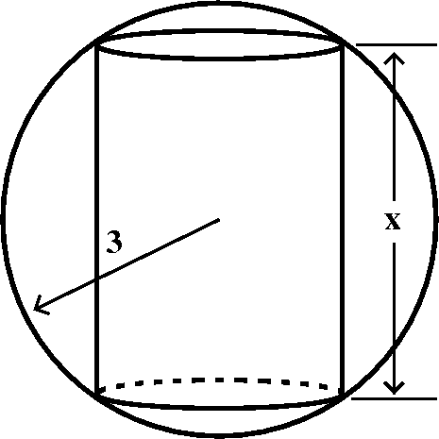
Size, material and weight
http://mymathforum.com/algebra/6911-sphere-cylinder.html
https://www.dummies.com/education/science/physics/calculating-the-force-needed-to-move-an-object-up-a-slope/
https://www.mathsteacher.com.au/year8/ch10_geomcons/09_cones/cylinder.htm
Notes:
*We need to decide on a size and stuff tonight so then we can say that this section has been taken care of – basically compare your excel results to the excel I created and then we can design it from there.

Slide 8
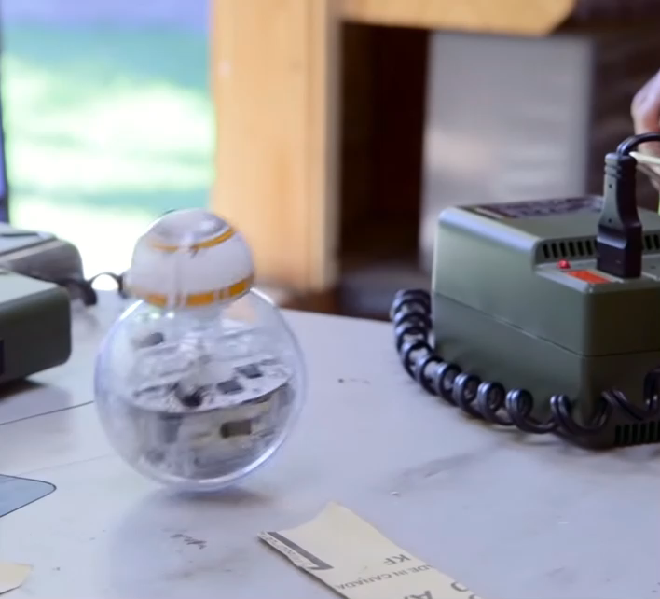
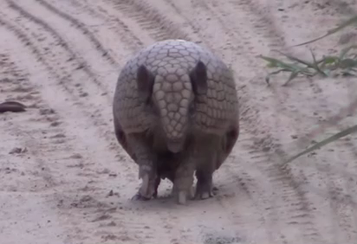
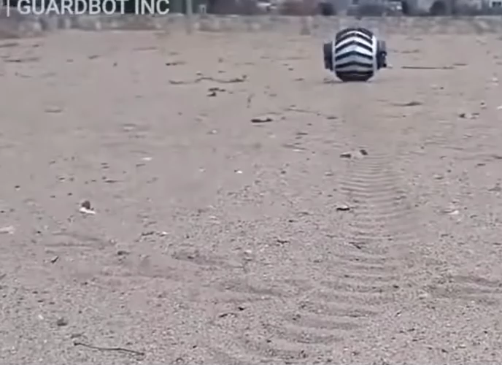
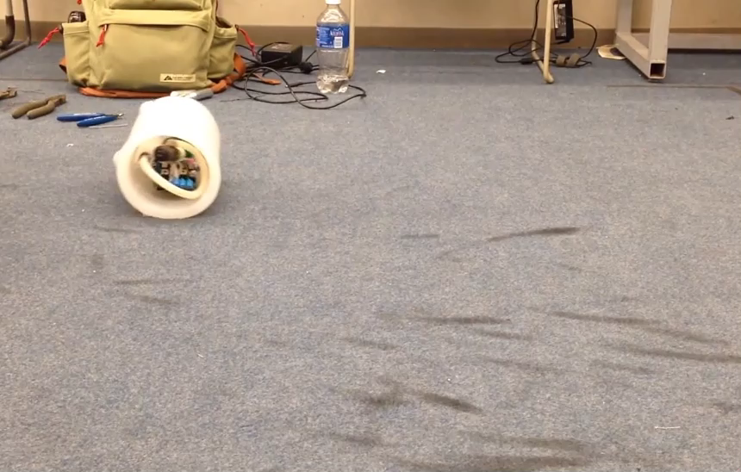
Questions?
Thanks for listening
Charlie Freestone & Becky Harding

